Slide 1
Quick Overview Of Azure AI Search using Security Filter
Filtering Azure AI Search Result with Users Group Permission
Using Group ID as a filter

Slide 2
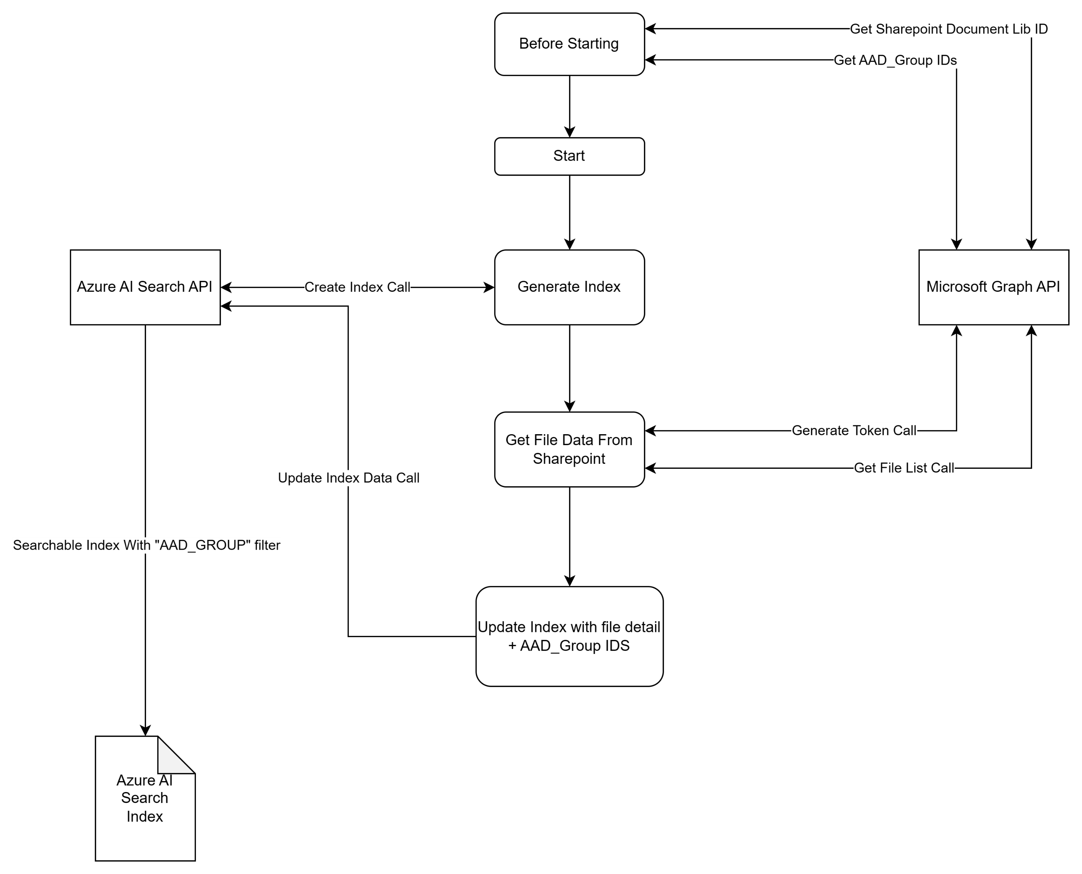
How Azure AI Search index is generated Via Demo App
Demo Console App
C-Sharp (dotnet 6.0)
Graph API
AI Search API

Slide 3
Demo Information
AAD
Group
teacher
ID: 7a4108af-6af1-4830-9bda-d85d45ad2020
student
ID: 98aa13aa-fcaa-4425-b1d7-32580a31f34c
List All Group for the User
https://graph.microsoft.com/v1.0/me/memberOf
SharePoint
jhl-test
Id: 1n5xj8.sharepoint.com,fc9cf324-f177-480e-86b6-ad055fa1c1fb,31ec7fcf-6125-419f-8cdf-8dc8fc968876
Document Library
Teacher-doc
Id: b!JPOc_HfxDkiGtq0FX6HB-89_7DElYZ9BjN-NyPyWiHaMLQTuMmUBTYpFPV-kGs6s
Student-doc
Id: b!JPOc_HfxDkiGtq0FX6HB-89_7DElYZ9BjN-NyPyWiHYRJq1kw5ZCRKepMYjulo1d
Azure AI Service
Index
sharepoint-index-demo
Query Example
{
"search": "in-network",
"filter": "AAD_GROUPS/any(g:search.in(g, '98aa13aa-fcaa-4425-b1d7-32580a31f34c'))"
}

Slide 4
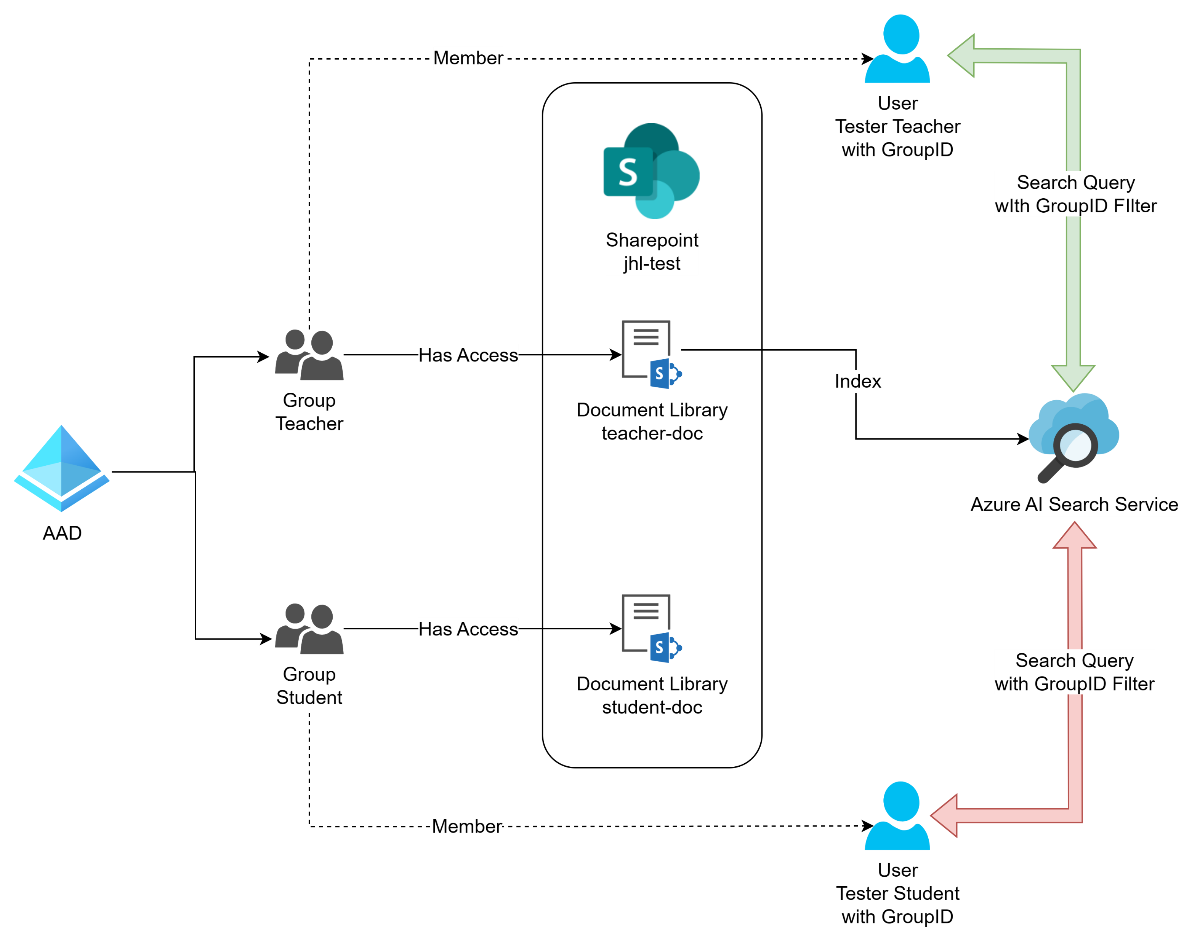
Overview of flow

Slide 5
Resources
Microsoft Graph
Microsoft Graph overview - Microsoft Graph | Microsoft Learn
Graph Explorer
https://developer.microsoft.com/en-us/graph/graph-explorer
Azure AI Search API
Search Service REST APIs - Azure AI Search | Microsoft Learn
Quick start to Azure AI Search Index
Quickstart: Create a search index using REST APIs - Azure AI Search | Microsoft Learn
Azure sharepoint indexer (preview)
SharePoint indexer (preview) - Azure AI Search | Microsoft Learn
Security Filters for trimming search results
Security filters for trimming results - Azure AI Search | Microsoft Learn
Security filters to trim results using MIcrosoft Entra ID - Azure AI Search | Microsoft Learn
Index Generator Sample
Code Used
https://github.com/juhyunlee8187/SPOIndexGenerator
Referenced document / code sample
(21) Chat with SharePoint Documents using Azure OpenAI and Azure Search | LinkedIn

